Slide 1


CITS5206 Working in Software Teams
Dr Caren Han
University of Western Australia

Slide 2
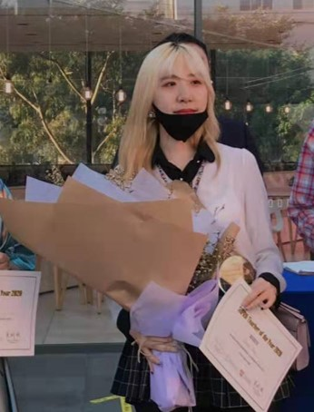
Guest Lecturer
Dr. Caren Han
Senior Lecturer
Education
B Computer Science (1st Class Honours, Medal)
PhD Computer Science (Artificial Intelligence)
Teaching
Received Australian Young Achiever Teaching Excellence Award
Received Teacher of the Year 2020 Award
Received Supervisor of the Year 2021 Award
Received Dean’s Teaching Excellence Award 2022
Teaching Natural Language Processing, Machine Learning, and Introduction to Programming
Research& Programming Experience
Published 70 papers (conference and journal articles)
Received NLP Top-tier Best Paper/Best Area Paper Award
Worked in Industry Projects: Google, Australia Defence Force, Thales, U.S. Air Force, U.S. Navy, NASA, Samsung, Hyundai etc.

Slide 3



Work as a Team
A team is a small group of people with complimentary skills who are committed to a common purpose for which they hold themselves and each other accountable.
Complimentary skills
Technical skill, problem-solving, decision-making, and interpersonal skills
Commitment Must make a strong commitment to a common purpose and goals
Accountability must hold themselves and each other answerable for meeting the team's goals.

Slide 4


Why have Teams?
Most companies organise their employees in multidisciplinary by function, such as engineering, finance, and marketing.
Working Together Team working together gets more results in less time
Organizational Parity By considering ideas equally, teams can produce creative and optimum results.
Job Satisfaction People on teams generally derive more satisfaction from their jobs.

Slide 5
Team Members and Leaders
Monitor the Performance of the Team
Monitor actual performance of the team in meeting its goals
Build commitment and confidence in the team members
Intimidation might work in some situations, but it will kill enthusiasm in a team. Team leaders need to focus on positive reinforcement.
Do Real Work
Every team member must do roughly equal amounts of work and that includes the team leader.
Often times the leader must set an example by volunteering to do jobs that no one else wants to do.

Slide 6



Team Development
Teams often go through steps or phases during their development.
Forming
Storming & Norming
Performing

Slide 7
Team Development – Forming
Teams often go through steps or phases during their development.
Forming
Storming & Norming
Performing

Slide 8

IceBreaker!
Your Name!
Your First Job!

Slide 9
Team Development – Storming
Teams often go through steps or phases during their development.
Forming
Storming & Norming
Performing

Slide 10







SWOT Analysis
Positive
Negative
Strengths
Weaknesses
What are your personal internal strengths or skill that you can lean on to achieve your project goal?
What prevented you from completing your project goal? In what areas do you need to improve?
Internal
Opportunities
Threats
What external opportunities such as resources or people, can you take advantage of to help you to achieve your project goal?
What external threats or obstacles do you face? What are your competitors doing that you are not?
External

Slide 11
SWOT Analysis - Example
Positive
Negative
Quick Learner
Creative
Good at Multi-task
Fluent Python Programming
Strengths
Weaknesses
Avoid Presentation (Nervous, Not Confident)
Procrastination
What are your personal internal strengths or skill that you can lean on to achieve your project goal?
What prevented you from completing your project goal? In what areas do you need to improve?
Internal
Opportunities
Threats
What external opportunities such as resources or people, can you take advantage of to help you to achieve your project goal?
What external threats or obstacles do you face? What are your competitors doing that you are not?
External
Our team is collaborating closely for preparation for the project.
The project requires me to be a main developer for reporting
Overload work
Lack of python packages to achieve the project goal

Slide 12

SHOW your own SWOT Analysis

Slide 13
Team Development – Norming
Teams often go through steps or phases during their development.
Forming
Storming & Norming
Performing

Slide 14
SWOT Analysis - Solution
Positive
Negative
Quick Learner
Creative
Good at Multi-task
Fluent Python Programming
Strengths
Weaknesses
Avoid Presentation (Nervous, Not Confident)
Procrastination
Practice presentation for the coming project demonstration
Internal
Communicate to the team leader for supporting the colleague’s duty
Make a to-do list (Trello), and set deadlines for team members and myself.
Divide the development task for our own package with team members
External
Our team is collaborating closely for preparation for the project.
The project requires me to be a main developer for reporting
Overload work
Lack of python packages to achieve the project goal
Opportunities
Threats

Slide 15

SHOW your own SWOT Solution

Slide 16
Team Development - Performing
Teams often go through steps or phases during their development.
Forming
Storming & Norming
Performing

Slide 17
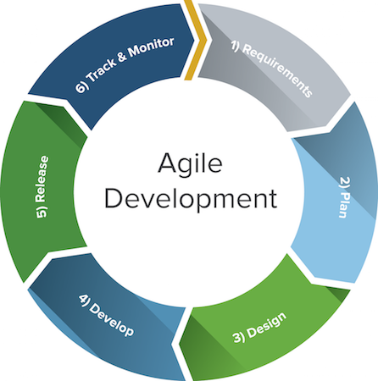
Clarifying the Mission
The team's mission is to produce a product/outcome that satisfies the Project Aim using the Agile Software Engineering process. Understanding the mission begins with understanding the product the team will produce.

Slide 18
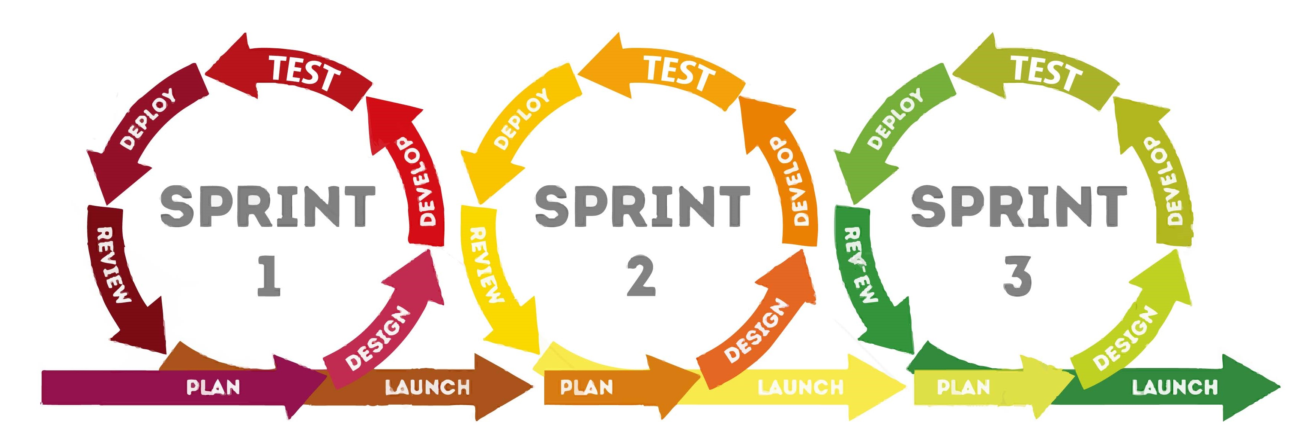
Clarifying the Mission
The team's mission is to produce a product/outcome that satisfies the Project Aim using the Agile Software Engineering process – sprint!. Understanding the mission begins with understanding the product the team will produce.

Slide 19
Clarifying the Mission and Milestones
The team's mission is to produce a product/outcome that satisfies the Project Aim using the Agile Software Engineering process. Understanding the mission begins with understanding the product the team will produce.
Real-World Example

Slide 20
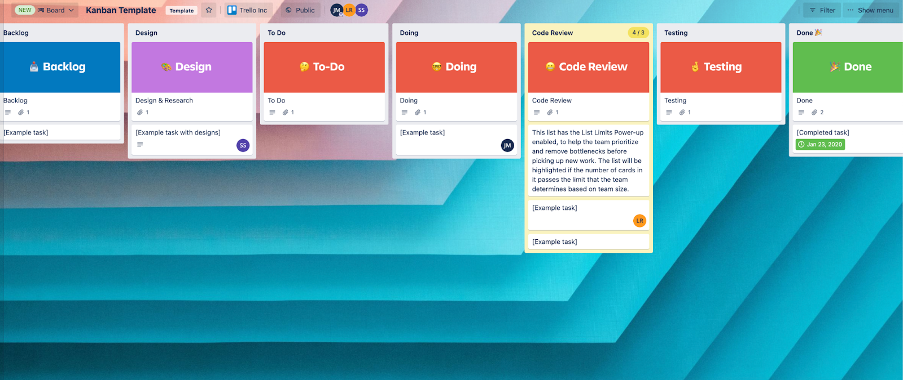
SHARE YOUR TRELLO!

Slide 21
Creating Processes
For a team to work efficiently, it needs a standard way of operating!
By defining processes, team members know how to accomplish team tasks
and they spend more time working on problems that contribute to the goal.
Standards of behaviour: Set some clear rules for behaviour. These rules should promote focus, openness, trust, and commitment.
Team communication: How will you keep each other informed of progress? When does the team plan to have the Meeting? When are other communication methods, like email or texting, appropriate?
Making decisions: What decisions can individuals make and what decisions must the team make? Will the team decide actions by voting or consensus? The best approach is to make decisions by consensus, not by voting. Voting divides a team into winners and losers, whereas consensus encourages each team member to cooperate.

Slide 22
GOOD LUCK WITH YOUR PROJECT!
Dr Caren Han
University of Western Australia

